Slide 1
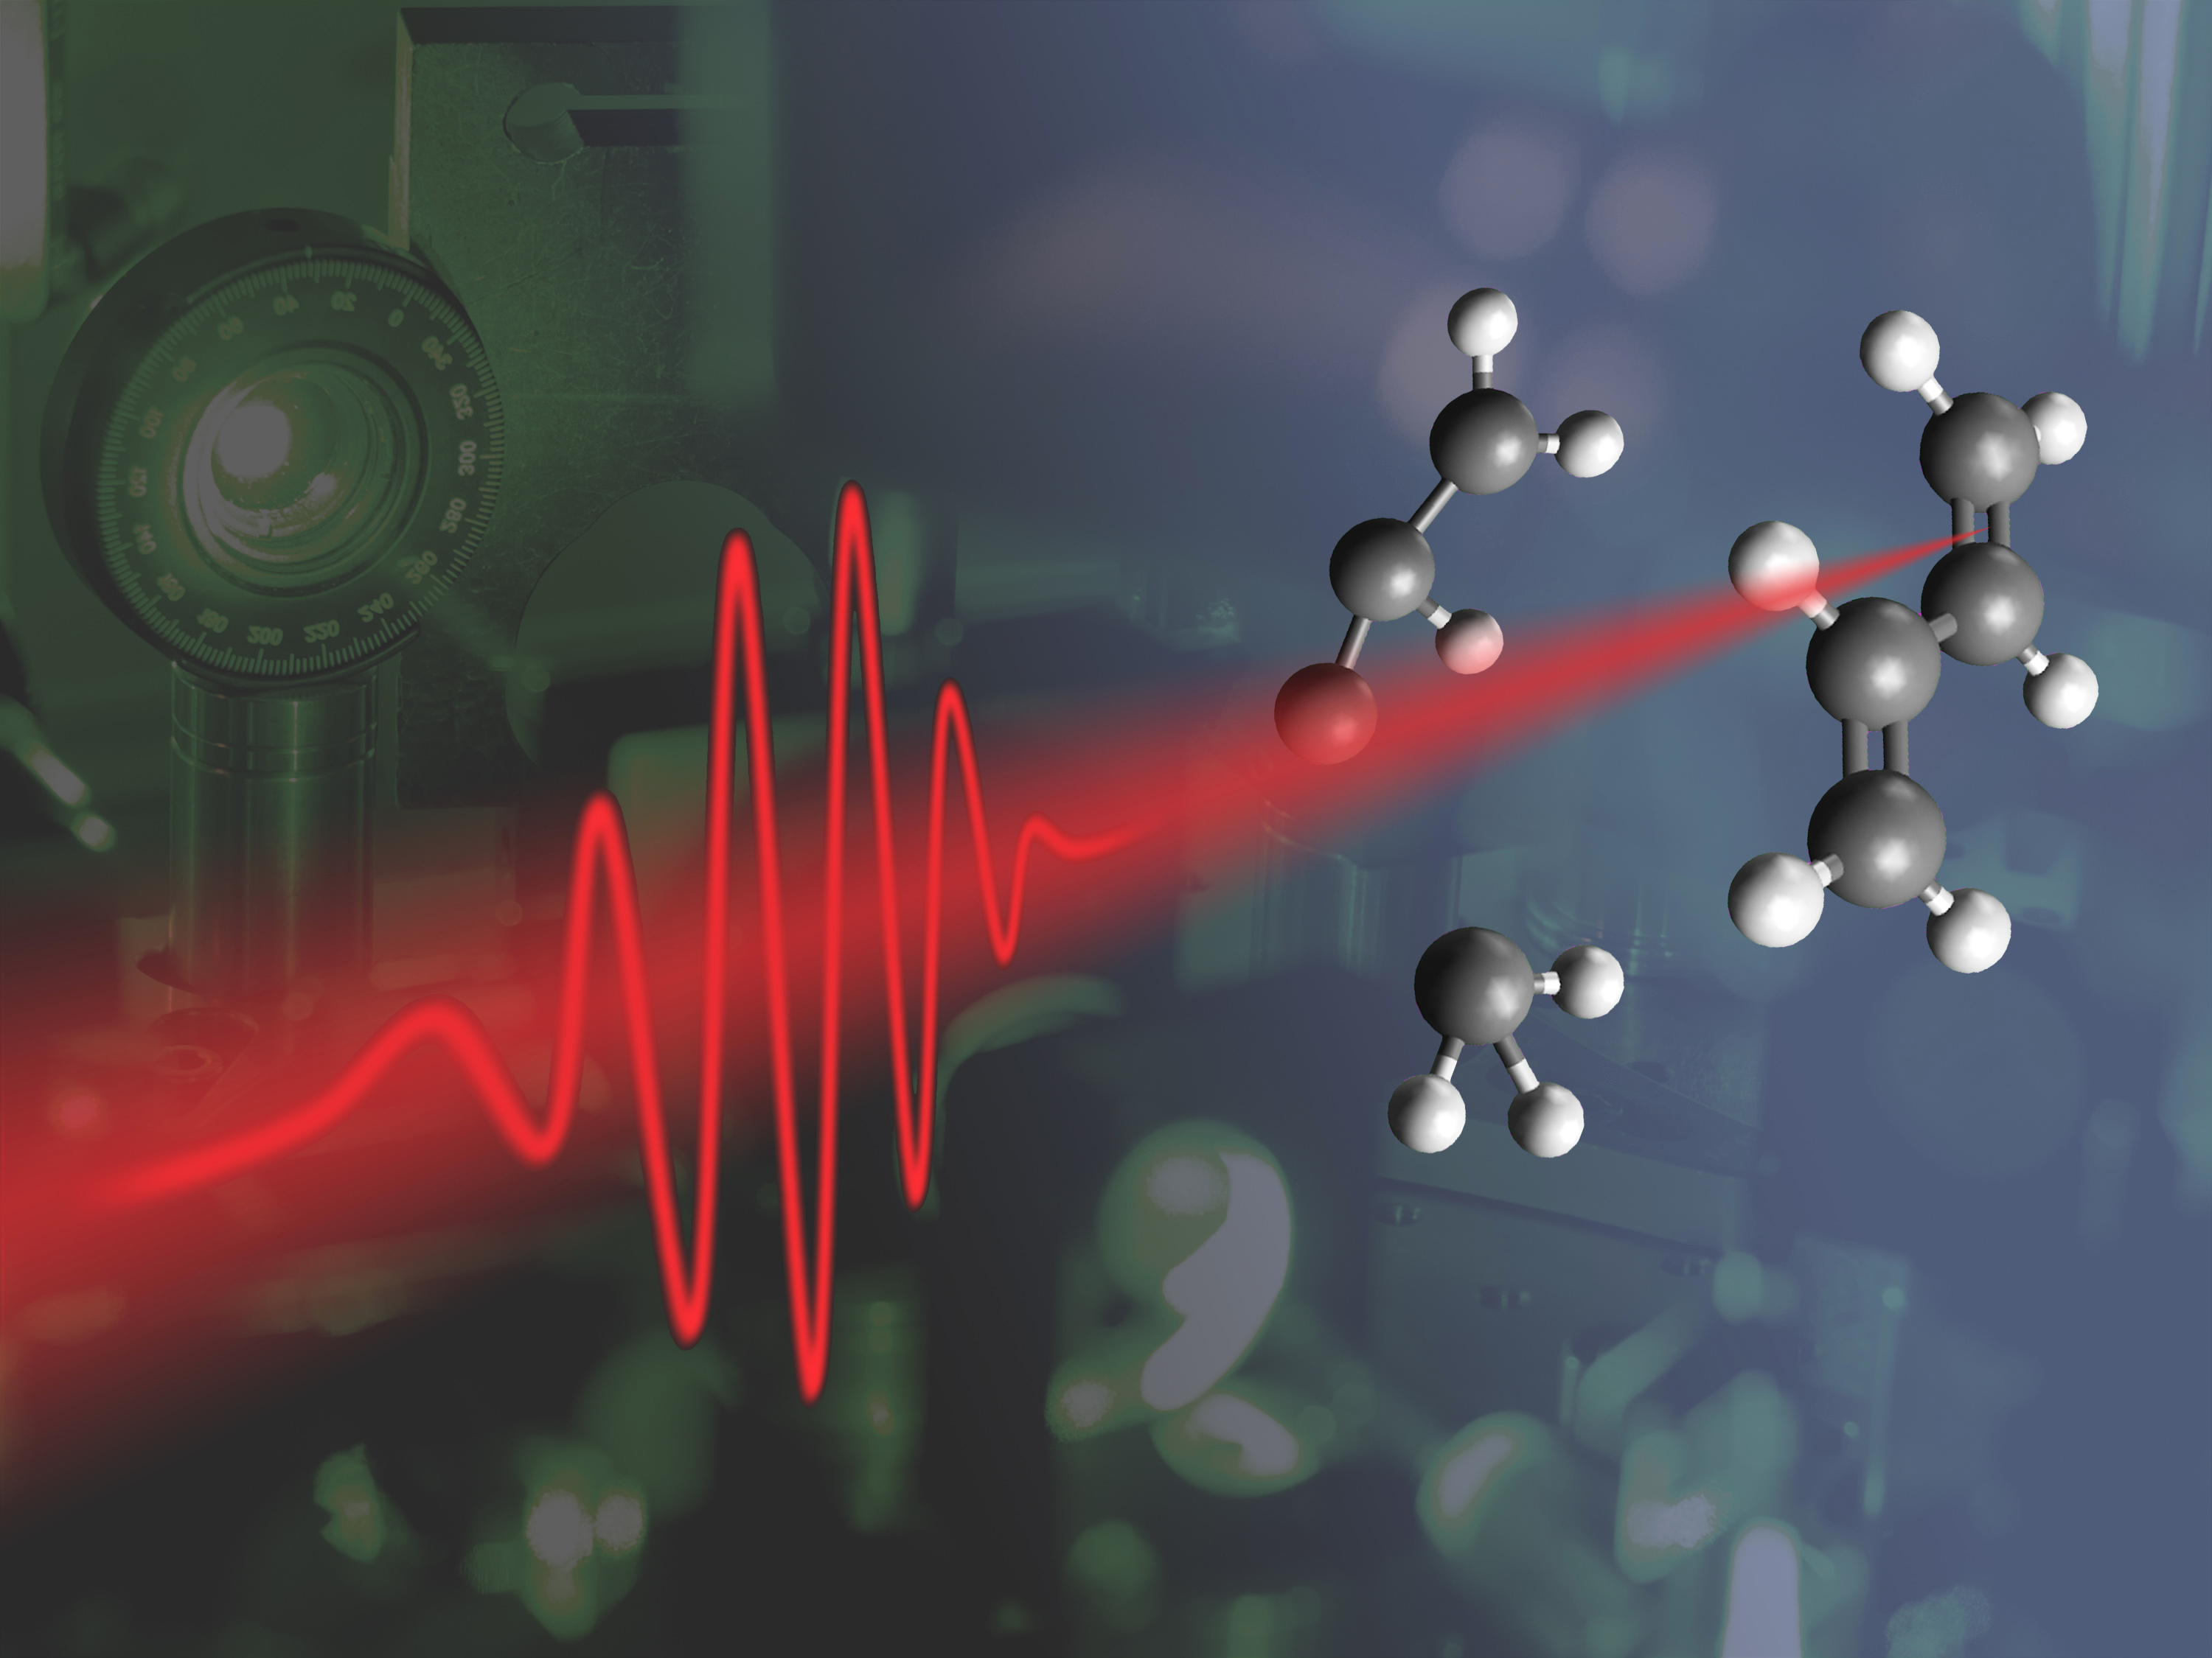
Pump-Probe Spectroscopy
Chelsey Dorow
Physics 211a

Slide 2
Applications of Pump-probe Spectroscopy
Pump-probe is a time resolved measurement, useful for studying dynamics of fast processes:
Atomic motion during chemical reactions.
Molecular vibrations.
Photon absorption and emission.
Many scattering phenomena.
Other processes that occur on fast time scales (up to ~10⁻¹⁸s).

Slide 3
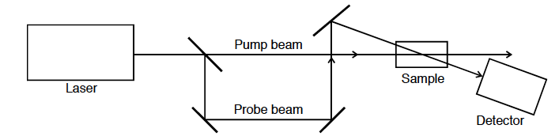
Experimental Technique
Pump beam: excites sample from equilibrium.
Probe beam: measures decay back to equilibrium.

Slide 4
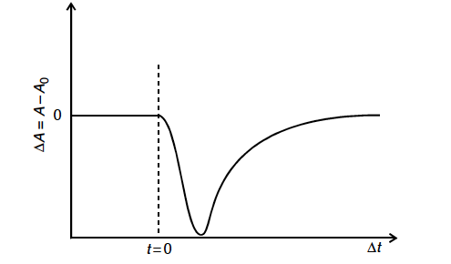
Population Dynamics with Pump-probe
Relative absorption of probe pulse
Pump excites electrons from E₁ to E₂.
Probe sees fewer electrons in E₁ that can be excited, less absorption.
Less absorption after pump pulse
Pump pulse applied at t=0

Slide 5
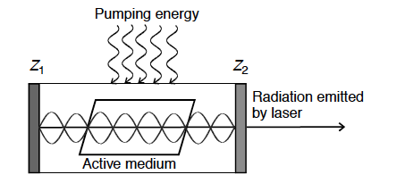
Ultrafast Laser Pulses
Ultrafast lasers
Active medium is excited with pumping energy.
Light is emitted via spontaneous and stimulated emission.
Some modes are reinforced as standing waves.
Reinforced modes are at random phases.
Reinforced modes:
λ=2L/n

Slide 6
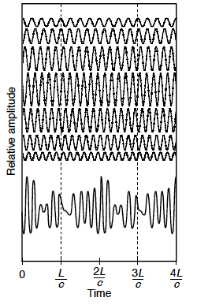
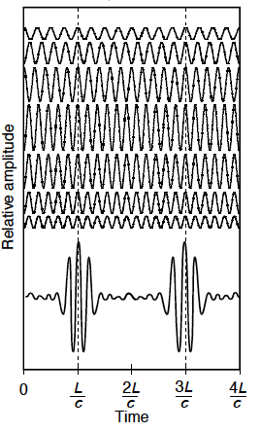
Ultrafast Laser Pulses
Mode-locking:
Random phases
In phase

Slide 7
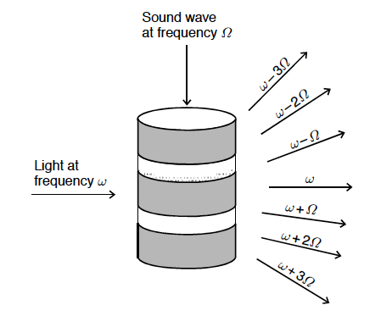
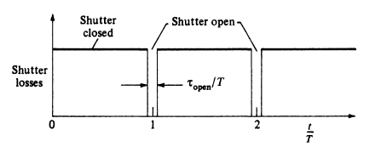
Ultrafast Laser Pulses
How to achieve mode-locking:
Must couple modes to each other.
Couple modes by modulating parameters of optical resonator with f=Ω (frequency spacing of the modes).
Resonant modes:
λ=2L/n
ω_{o}±nΩ

Slide 8
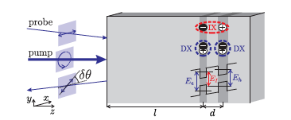


Goal: Measure IXs with pump-probe spectroscopy despite low oscillator strength. Measure IXs indirectly by studying the IX effect on the DX signal.
Reflectivity of DXs
IX affects DX reflectivity in 3 ways:
Nalitov, A. V., et al. "Nonlinear optical probe of indirect excitons." Physical Review B 89.15 (2014): 155309.
Andreakou, P., et al. "Nonlinear optical spectroscopy of indirect excitons in biased coupled quantum wells." arXiv preprint arXiv:1407.5500 (2014).

Slide 9
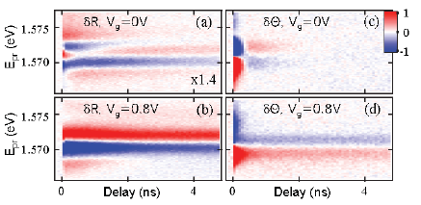
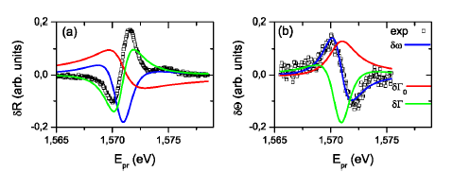
Reflectivity and Kerr Rotation of DX
Can fit to theoretical calculations to determine which interactions between IX and DX are most prevalent.

Slide 10
References:
Nalitov, A. V., et al. "Nonlinear optical probe of indirect excitons." Physical Review B 89.15 (2014): 155309.
Andreakou, P., et al. "Nonlinear optical spectroscopy of indirect excitons in biased coupled quantum wells." arXiv preprint arXiv:1407.5500 (2014).
Abramczyk, Halina. Introduction to Laser Spectroscopy. Amsterdam: Elsevier, 2005.
Amnon Yariv. Optical Electronics. Saunders College Publishing, Philadelphia, 4 edition, 1991.

